Slide 1

Testing

Slide 2
Background
Main objectives of a project: High Quality & High Productivity (Q&P)
Quality has many dimensions
  reliability, maintainability, interoperability etc.
Reliability is perhaps the most important
Reliability: The chances of software failing
More defects => more chances of failure => lesser reliability
Hence quality goal: Have as few defects as possible in the delivered software!
Testing

Slide 3
Faults & Failure
Failure: A software failure occurs if the behavior of the s/w is different from expected/specified.
Fault: cause of software failure
Fault = bug = defect
Failure implies presence of defects
A defect has the potential to cause failure.
Definition of a defect is environment, project specific
Testing

Slide 4
Role of Testing
Identify defects remaining after the review processes!
Reviews are human processes - can not catch all defects
There will be requirement defects, design defects and coding defects in code
Testing:
  Detects defects
  plays a critical role in ensuring quality.
Testing

Slide 5
Detecting defects in Testing
During testing, a program is executed with a set of test cases
Failure during testing => defects are present
No failure => confidence grows, but can not say “defects are absent”
Defects detected through failures
To detect defects, must cause failures during testing
Testing

Slide 6
Test Oracle
To check if a failure has occurred when executed with a test case, we need to know the correct behavior
That is we need a test oracle, which is often a human
Human oracle makes each test case expensive as someone has to check the correctness of its output
Testing

Slide 7
Common Test Oracles
specifications and documentation,
other products (for instance, an oracle for a software program might be a second program that uses a different algorithm to evaluate the same mathematical expression as the product under test)
an heuristic oracle that provides approximate results or exact results for a set of a few test inputs,
a statistical oracle that uses statistical characteristics,
a consistency oracle that compares the results of one test execution to another for similarity,
a model-based oracle that uses the same model to generate and verify system behavior,
or a human being's judgment (i.e. does the program "seem" to the user to do the correct thing?).
Testing

Slide 8
Role of Test cases
Ideally would like the following for test cases
  No failure implies “no defects” or “high quality”
  If defects present, then some test case causes a failure
Psychology of testing is important
  should be to ‘reveal’ defects(not to show that it works!)
  test cases must be “destructive”
Role of test cases is clearly very critical
Only if test cases are “good”, the confidence increases after testing
Testing

Slide 9
Test case design
During test planning, have to design a set of test cases that will detect defects present
Some criteria needed to guide test case selection
Two approaches to design test cases
  functional or black box
  structural or white box
Both are complimentary; we discuss a few approaches/criteria for both
Testing

Slide 10
Black Box testing
Software tested to be treated as a block box
Specification for the black box is given
The expected behavior of the system is used to design test cases
Test cases are determined solely from specification.
Internal structure of code not used for test case design
Testing

Slide 11
Black Box Testing…
Most thorough functional testing - exhaustive testing
  Software is designed to work for an input space
  Test the software with all elements in the input space
Infeasible - too high a cost
Need better method for selecting test cases
Different approaches have been proposed
Testing

Slide 12
Equivalence Class partitioning
Divide the input space into equivalent classes
If the software works for a test case from a class the it is likely to work for all
Can reduce the set of test cases if such equivalent classes can be identified
Approximate it by identifying classes for which different behavior is specified
Testing

Slide 13
Equivalence Class Examples
In a computer store, the computer item can have a quantity
between -500 to +500. What are the equivalence classes?
Answer: Valid class: -500 <= QTY <= +500
Invalid class: QTY > +500
Invalid class: QTY < -500
Testing

Slide 14
Equivalence Class Examples
Account code can be 500 to 1000 or 0 to 499 or 2000 (the field type is integer). What are the equivalence classes?
Answer:
Valid class: 0 <= account <= 499
Valid class: 500 <= account <= 1000
Valid class: 2000 <= account <= 2000
Invalid class: account < 0
Invalid class: 1000 < account < 2000
Invalid class: account > 2000
Testing

Slide 15
Equivalence class partitioning…
Rationale: specification requires same behavior for elements in a class
Software likely to be constructed such that it either fails for all or for none.
E.g. if a function was not designed for negative numbers then it will fail for all the negative numbers
For robustness, should form equivalent classes for invalid inputs also
Testing

Slide 16
Equivalent class partitioning..
Every condition specified as input is an equivalent class
Define invalid equivalent classes also
E.g. range 0< value<Max specified
  one range is the valid class
  input < 0 is an invalid class
  input > max is an invalid class
Whenever that entire range may not be treated uniformly - split into classes
Testing

Slide 17
Equivalence class…
Once eq classes selected for each of the inputs, test cases have to be selected
  Select each test case covering as many valid equivalence classes as possible
  Or, have a test case that covers at most one valid class for each input
  Plus a separate test case for each invalid class
Testing

Slide 18
Example
Consider a program that takes 2 inputs – a string s and an integer n
Program determines n most frequent characters
Tester believes that programmer may deal with diff types of chars separately
Describe a valid and invalid equivalence classes
Testing

Slide 19
Example..
Input | Valid Eq Class | Invalid Eq class
S | 1: Contains numbers 2: Lower case letters 3: upper case letters 4: special chars 5: str len between 0-N(max) | 1: non-ascii char 2: str len > N
N | 6: Int in valid range | 3: Int out of range
Testing

Slide 20
Example…
Test cases (i.e. s , n) with first method
  s : str of len < N with lower case, upper case, numbers, and special chars, and n=5
  Plus test cases for each of the invalid eq classes
  Total test cases: 1 valid+3 invalid= 4 total
With the second approach
  A separate str for each type of char (i.e. a str of numbers, one of lower case, …) + invalid cases
  Total test cases will be 6 + 3 = 9
Testing

Slide 21
Boundary value analysis
Programs often fail on special values
These values often lie on boundary of equivalence classes
Test cases that have boundary values have high yield
These are also called extreme cases
A BV test case is a set of input data that lies on the edge of a eq class of input/output
Testing

Slide 22
Boundary value analysis (cont)...
For each equivalence class
  choose values on the edges of the class
  choose values just outside the edges
E.g. if 0 <= x <= 1.0
  0.0 , 1.0 are edges inside
  -0.1,1.1 are just outside
E.g. a bounded list - have a null list , a maximum value list
Consider outputs also and have test cases generate outputs on the boundary
Testing

Slide 23
Boundary Value Analysis
In BVA we determine the value of vars that should be used
If input is a defined range, then there are 6 boundary values plus 1 normal value (tot: 7)
If multiple inputs, how to combine them into test cases; two strategies possible
  Try all possible combination of BV of diff variables, with n vars this will have 7^{n} test cases!
  Select BV for one var; have other vars at normal values + 1 of all normal values
Min
Max
Testing

Slide 24
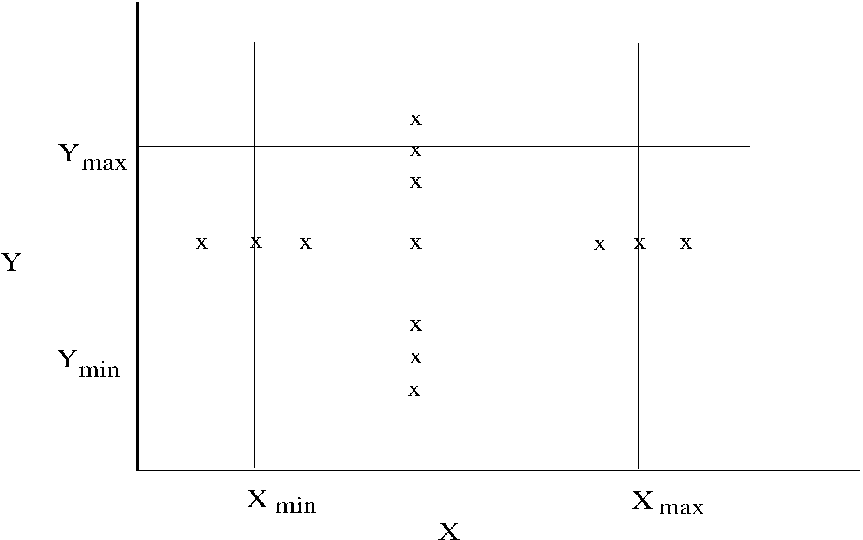
BVA.. (test cases for two vars – x and y)
Testing

